Slide 1
Signals

Slide 2
3.1 Analog and Digital
Analog and Digital Data
Analog and Digital Signals
Periodic and Aperiodic Signals

Slide 3

Note:
Signals can be analog or digital. Analog signals can have an infinite number of values in a range; digital signals can have only a limited number of values.

Slide 4
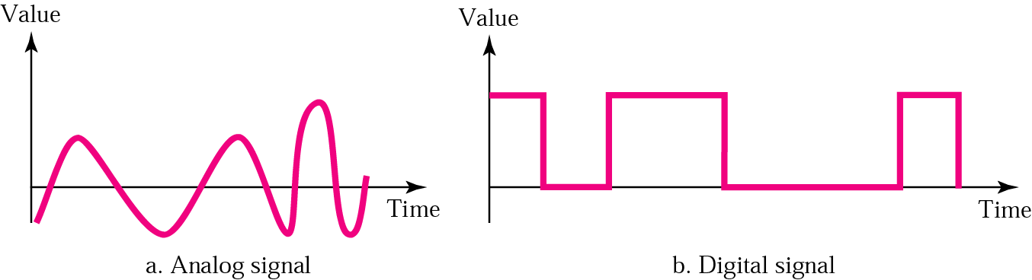
Figure 3.1 Comparison of analog and digital signals

Slide 5
Note:
In data communication, we commonly use periodic analog signals and aperiodic digital signals.

Slide 6
3.2 Analog Signals
Sine Wave
Phase
Examples of Sine Waves
Time and Frequency Domains
Composite Signals
Bandwidth

Slide 7
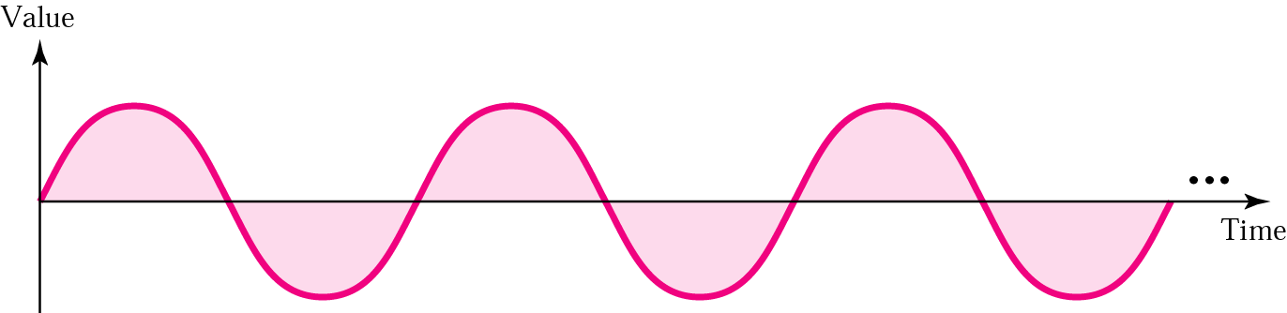
Figure 3.2 A sine wave

Slide 8
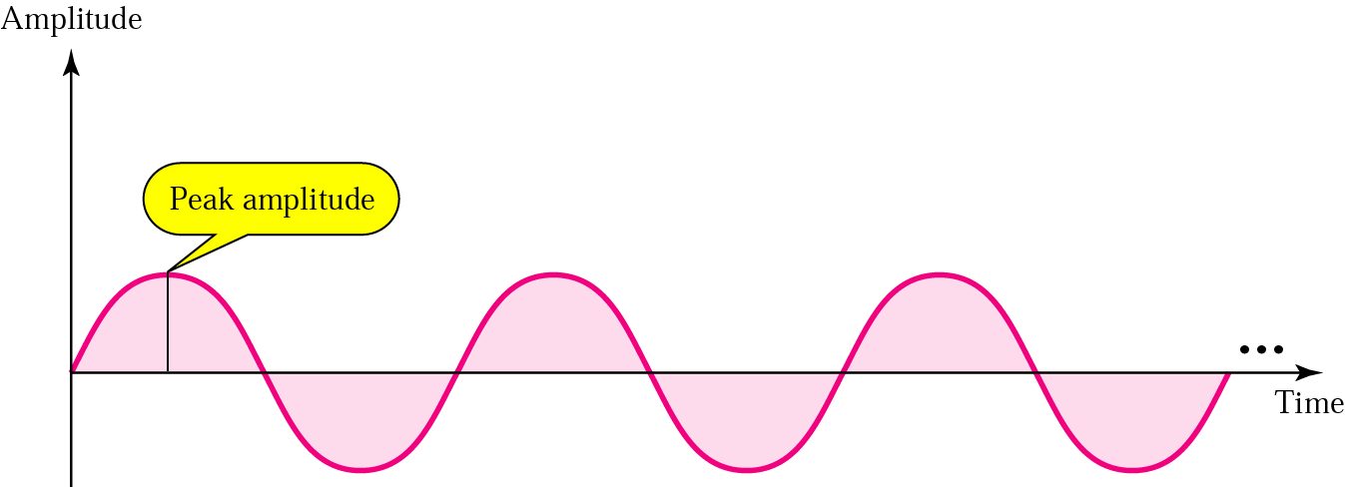
Figure 3.3 Amplitude

Slide 9
Note:
Frequency and period are inverses of each other.

Slide 10
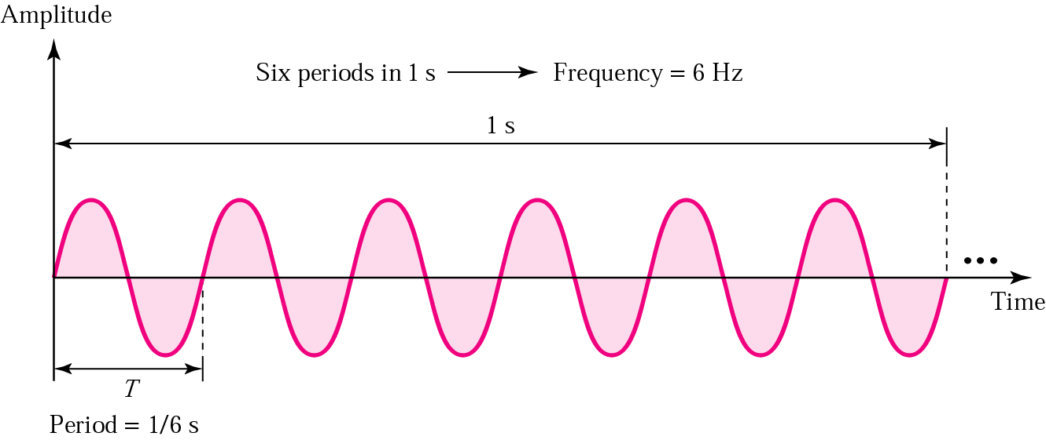
Figure 3.4 Period and frequency

Slide 11
Table 3.1 Units of periods and frequencies
Unit | Equivalent | Unit | Equivalent
Seconds (s) | 1 s | hertz (Hz) | 1 Hz
Milliseconds (ms) | 10^{–3} s | kilohertz (KHz) | 10³ Hz
Microseconds (ms) | 10^{–6} s | megahertz (MHz) | 10⁶ Hz
Nanoseconds (ns) | 10^{–9} s | gigahertz (GHz) | 10⁹ Hz
Picoseconds (ps) | 10^{–12} s | terahertz (THz) | 10¹² Hz

Slide 12
Example 1
Express a period of 100 ms in microseconds, and express the corresponding frequency in kilohertz.
Solution
From Table 3.1 we find the equivalent of 1 ms.We make the following substitutions:
100 ms = 100 × 10⁻³ s = 100 × 10⁻³ × 10⁶ μs = 10⁵ μs
Now we use the inverse relationship to find the frequency, changing hertz to kilohertz
100 ms = 100 × 10⁻³ s = 10⁻¹ s
f = 1/10⁻¹ Hz = 10 × 10⁻³ KHz = 10⁻² KHz

Slide 13
Note:
Frequency is the rate of change with respect to time. Change in a short span of time means high frequency. Change over a long span of time means low frequency.

Slide 14
Note:
If a signal does not change at all, its frequency is zero. If a signal changes instantaneously, its frequency is infinite.

Slide 15
Note:
Phase describes the position of the waveform relative to time zero.

Slide 16
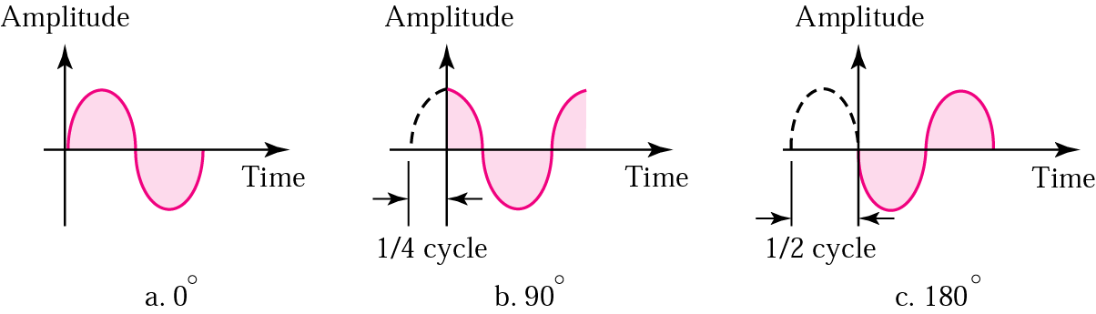
Figure 3.5 Relationships between different phases

Slide 17
Example 2
A sine wave is offset one-sixth of a cycle with respect to time zero. What is its phase in degrees and radians?
Solution
We know that one complete cycle is 360 degrees.
Therefore, 1/6 cycle is
(1/6) 360 = 60 degrees = 60 x 2π /360 rad = 1.046 rad

Slide 18
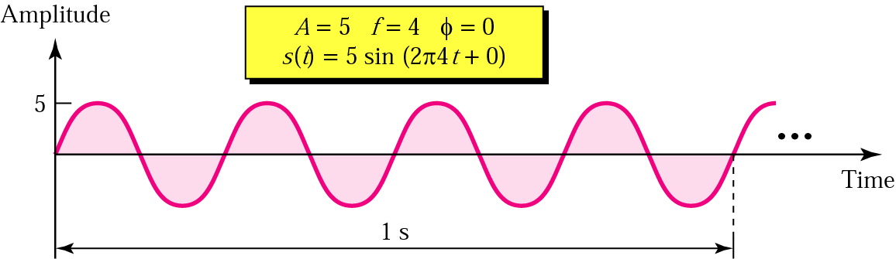
Figure 3.6 Sine wave examples

Slide 19
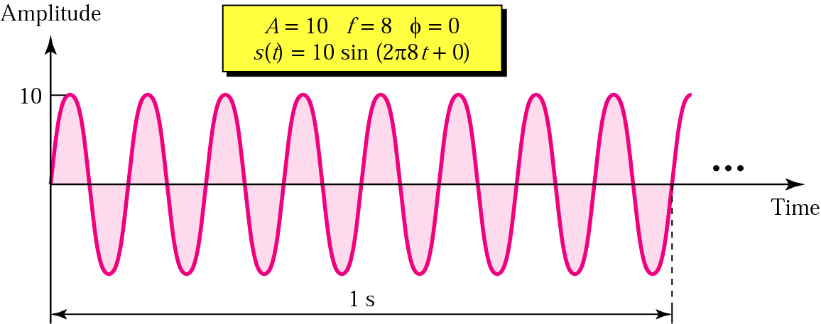
Figure 3.6 Sine wave examples (continued)

Slide 20
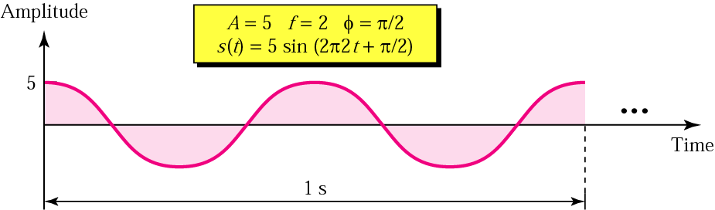
Figure 3.6 Sine wave examples (continued)

Slide 21
Note:
An analog signal is best represented in the frequency domain.

Slide 22
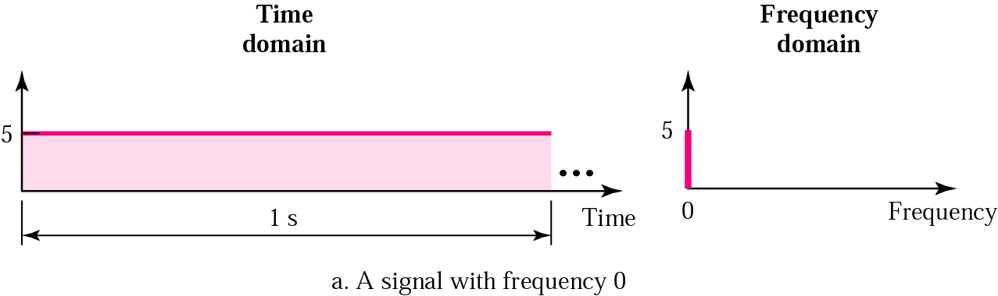
Figure 3.7 Time and frequency domains

Slide 23
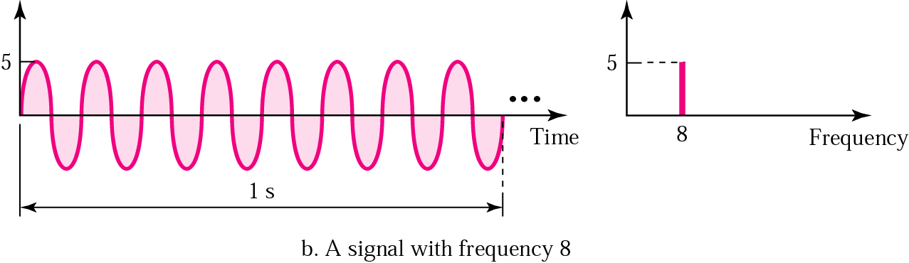
Figure 3.7 Time and frequency domains (continued)

Slide 24
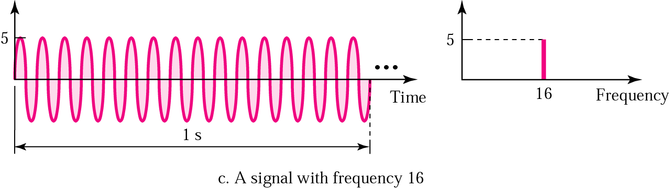
Figure 3.7 Time and frequency domains (continued)

Slide 25
Note:
A single-frequency sine wave is not useful in data communications; we need to change one or more of its characteristics to make it useful.

Slide 26
Note:
When we change one or more characteristics of a single-frequency signal, it becomes a composite signal made of many frequencies.

Slide 27
Note:
According to Fourier analysis, any composite signal can be represented as a combination of simple sine waves with different frequencies, phases, and amplitudes.

Slide 28
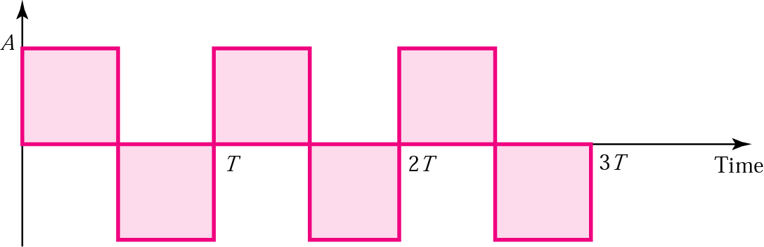
Figure 3.8 Square wave

Slide 29
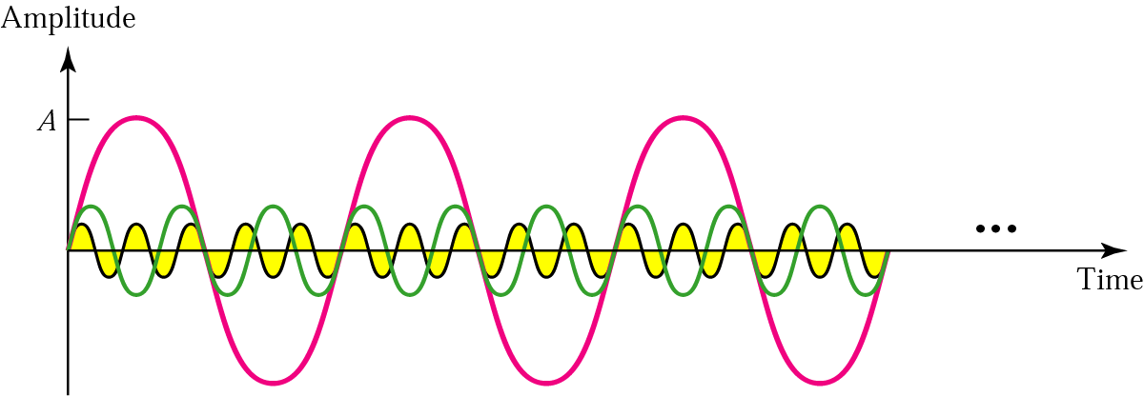
Figure 3.9 Three harmonics

Slide 30
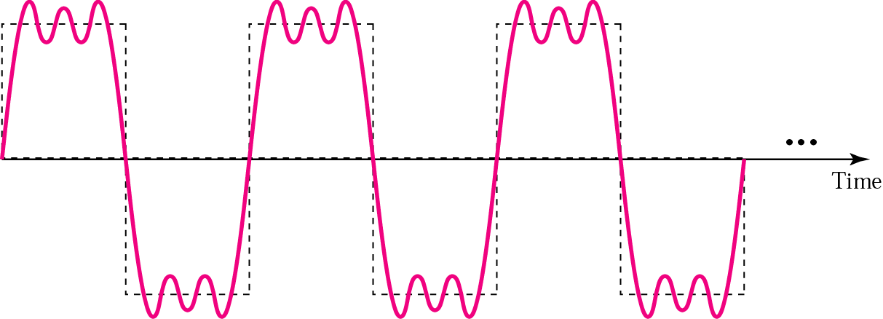
Figure 3.10 Adding first three harmonics

Slide 31
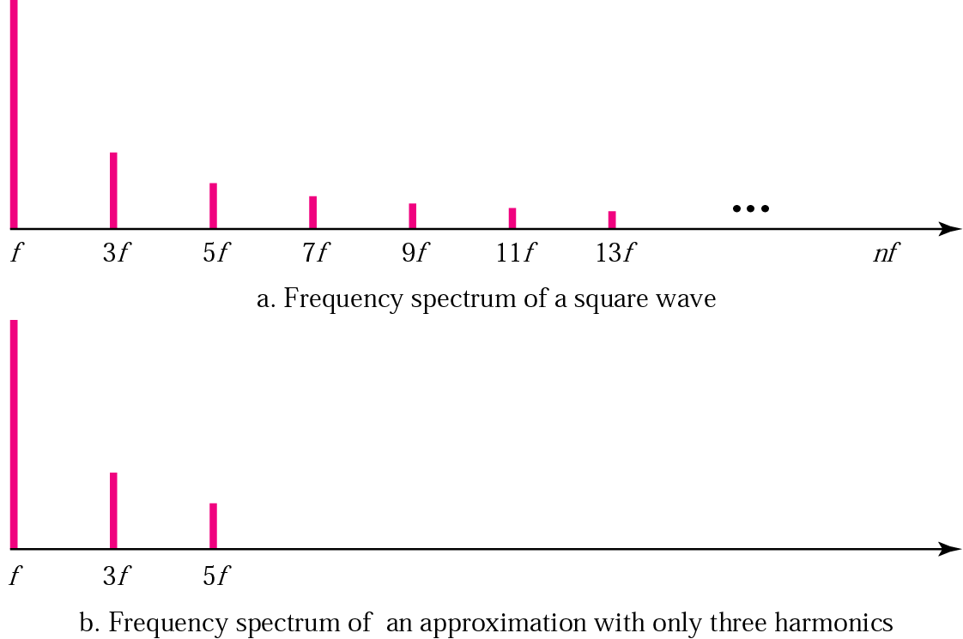
Figure 3.11 Frequency spectrum comparison

Slide 32
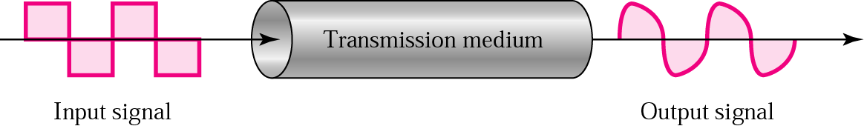
Figure 3.12 Signal corruption

Slide 33
Note:
The bandwidth is a property of a medium: It is the difference between the highest and the lowest frequencies that the medium can
satisfactorily pass.

Slide 34
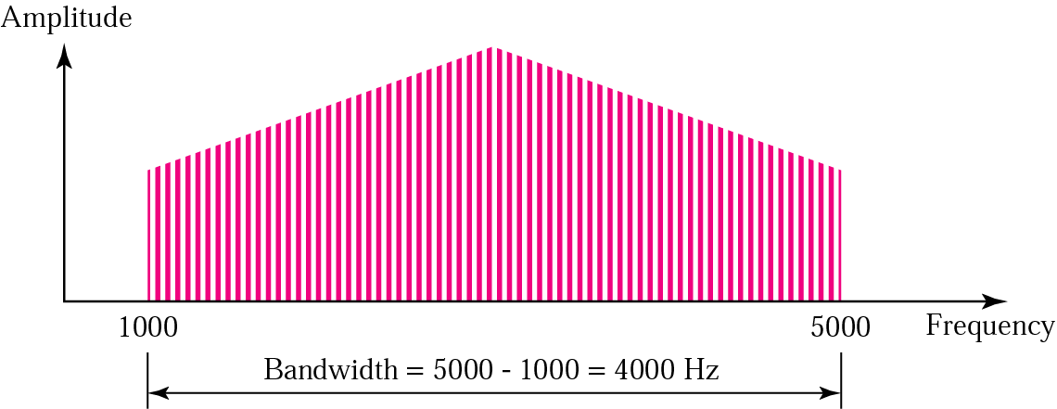
Figure 3.13 Bandwidth

Slide 35
Example 3
If a periodic signal is decomposed into five sine waves with frequencies of 100, 300, 500, 700, and 900 Hz, what is the bandwidth? Draw the spectrum, assuming all components have a maximum amplitude of 10 V.
Solution
B = f_{h} − f_{l} = 900 − 100 = 800 Hz
The spectrum has only five spikes, at 100, 300, 500, 700, and 900 (see Figure 13.4 )

Slide 36
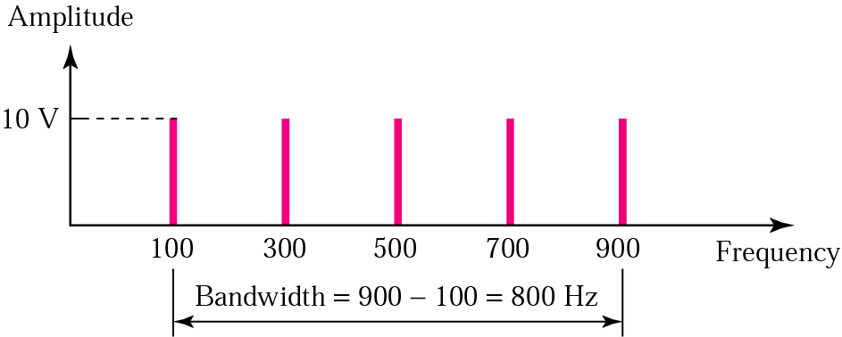
Figure 3.14 Example 3

Slide 37
Example 4
A signal has a bandwidth of 20 Hz. The highest frequency is 60 Hz. What is the lowest frequency? Draw the spectrum if the signal contains all integral frequencies of the same amplitude.
Solution
B = f_{h} − f_{l}
20 = 60 − f_{l}
f_{l} = 60 − 20 = 40 Hz

Slide 38
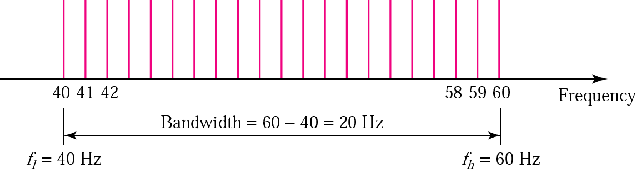
Figure 3.15 Example 4

Slide 39
Example 5
A signal has a spectrum with frequencies between 1000 and 2000 Hz (bandwidth of 1000 Hz). A medium can pass frequencies from 3000 to 4000 Hz (a bandwidth of 1000 Hz). Can this signal faithfully pass through this medium?
Solution
The answer is definitely no. Although the signal can have the same bandwidth (1000 Hz), the range does not overlap. The medium can only pass the frequencies between 3000 and 4000 Hz; the signal is totally lost.

Slide 40
Digital Signals
Bit Interval and Bit Rate
As a Composite Analog Signal
Through Wide-Bandwidth Medium
Through Band-Limited Medium
Versus Analog Bandwidth
Higher Bit Rate

Slide 41
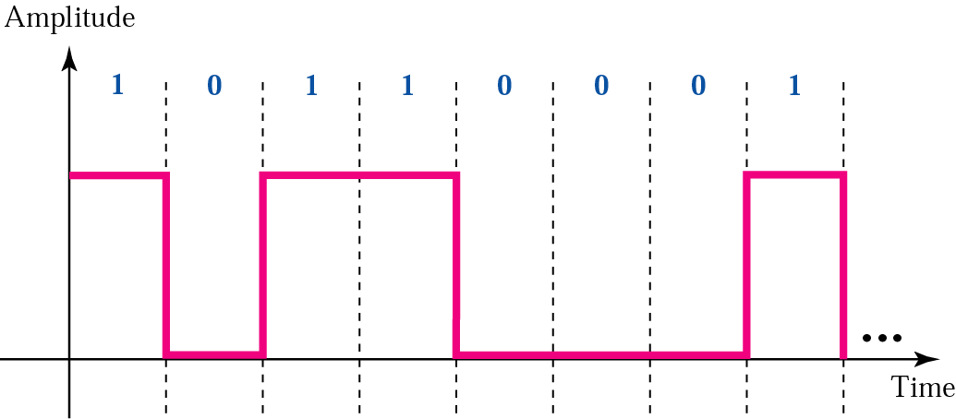
Figure 3.16 A digital signal

Slide 42
Example 6
A digital signal has a bit rate of 2000 bps. What is the duration of each bit (bit interval)
Solution
The bit interval is the inverse of the bit rate.
Bit interval = 1/ 2000 s = 0.000500 s
= 0.000500 x 10⁶ μs = 500 μs

Slide 43
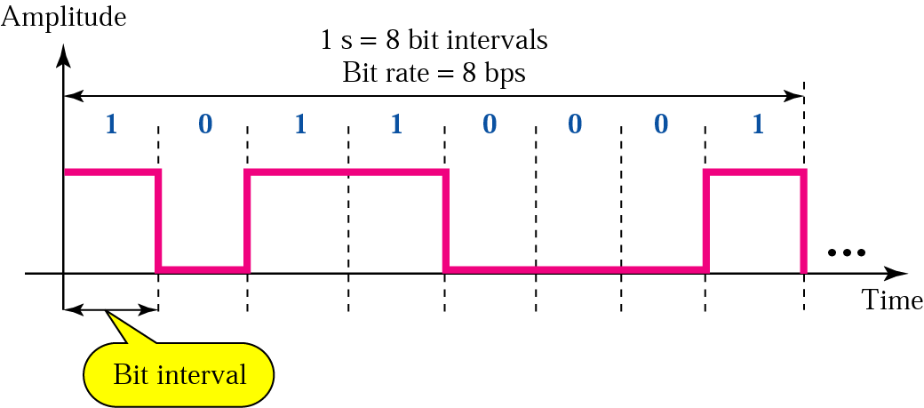
Figure 3.17 Bit rate and bit interval

Slide 44
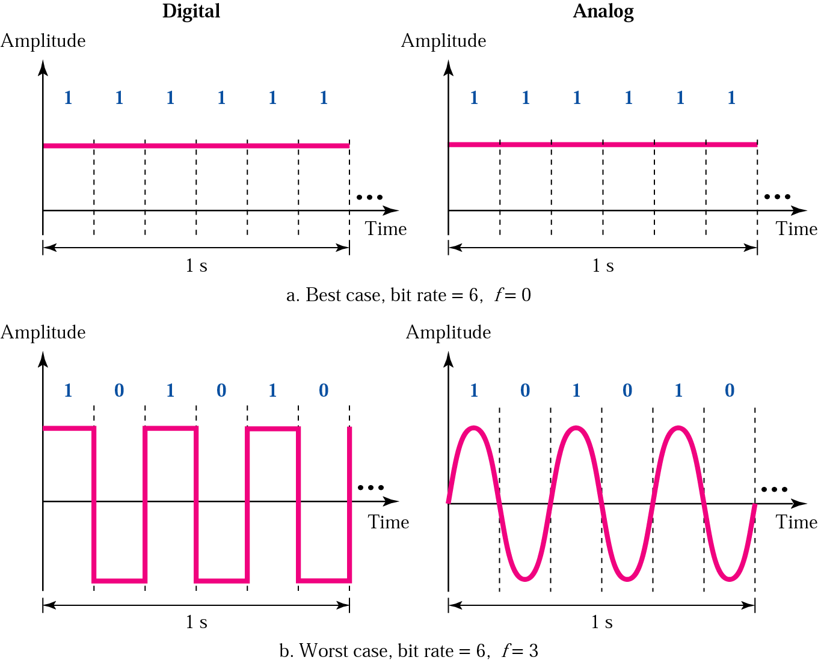
Figure 3.18 Digital versus analog

Slide 45
Note:
A digital signal is a composite signal with an infinite bandwidth.

Slide 46
Table 3.12 Bandwidth Requirement
Bit Rate | Harmonic 1 | Harmonics 1, 3 | Harmonics 1, 3, 5 | Harmonics 1, 3, 5, 7
1 Kbps | 500 Hz | 2 KHz | 4.5 KHz | 8 KHz
10 Kbps | 5 KHz | 20 KHz | 45 KHz | 80 KHz
100 Kbps | 50 KHz | 200 KHz | 450 KHz | 800 KHz

Slide 47
Note:
The bit rate and the bandwidth are proportional to each other.

Slide 48
Note:
The analog bandwidth of a medium is expressed in hertz; the digital bandwidth, in bits per second.

Slide 49
Note:
Digital transmission needs a
low-pass channel.

Slide 50
Note:
Analog transmission can use a band-pass channel.

